Slide 1
CUEA UNIT REGISTRATION GUIDE!!

Slide 2
Step 1: Login to Student Portal
Navigate to https://studentportal.cuea.edu/ and Login to the Student Portal.

Slide 3
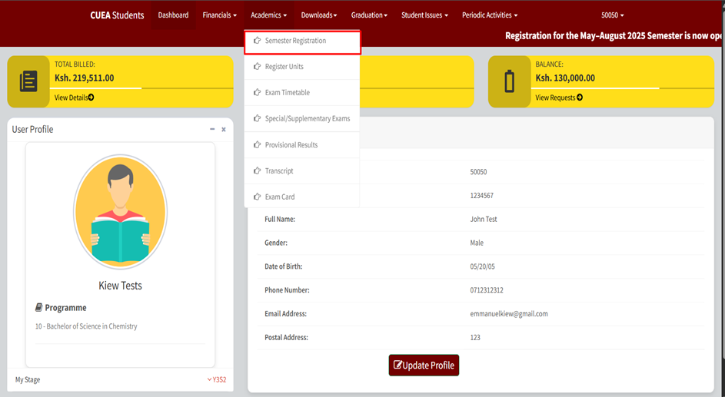
Step 2: Semester Registration
Navigate to Academics.
Click on Semester Registration.

Slide 4
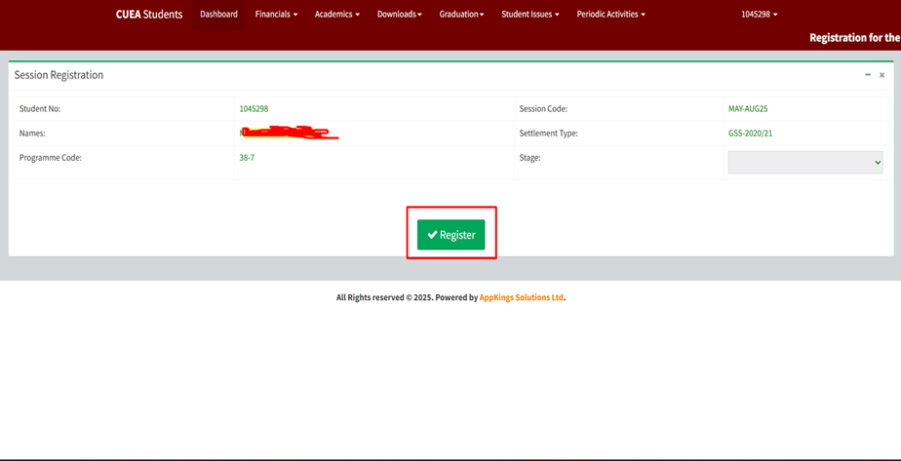
Step 3: Create Session
Click “Register button” to create session.

Slide 5
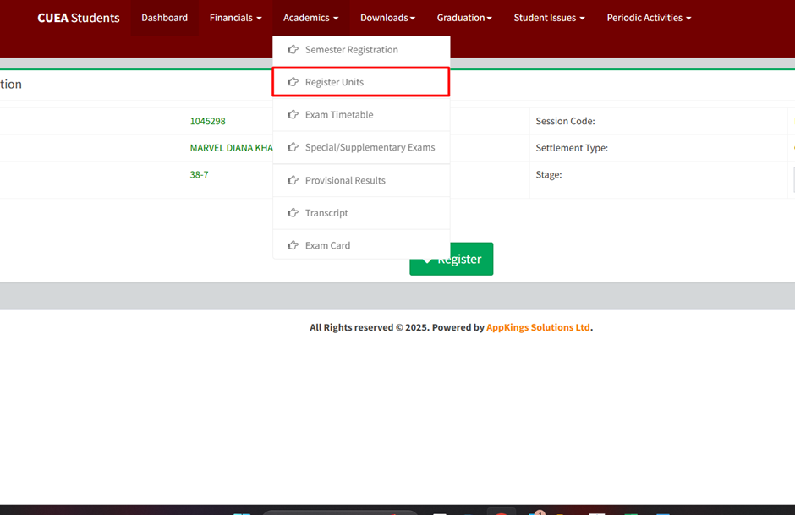
Step 4: Register Units
click “Register Units” under academic

Slide 6
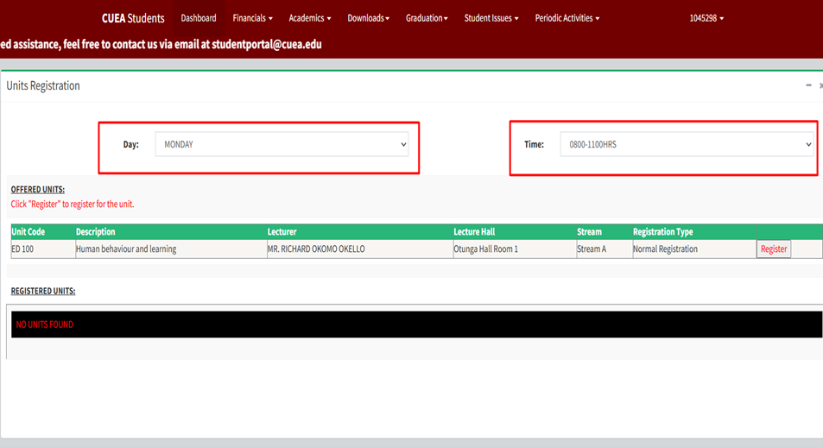
Step 5: Select Time and Day
Select Day and Time from the drop downs

Slide 7
Step 6: Register for Available units
Select register button under the “offered units” option

Slide 8
Step 7: View registered units
Registered units will be shown under “registered units” option

Slide 9
Step 8: Register Another unit?
Repeat step 4-6 until you have registered for all semester units

Slide 10
10
This Photo by Unknown Author is licensed under CC BY

